Slide 1
HYPOTHESIS TESTING T-test analysis of Variance (ANOVA)

Slide 2
Agenda
Principles of Hypothesis Testing
Comparing Two Means: Two-Samples t-Test
Comparing More than Two Means: ANOVA
Example Using SPSS

Slide 3
Principles of Hypothesis Testing
1.
Formulate the hypothesis
2.
Choose the significance level
3.
Select an appropriate test and check assumptions
Define the testing situation
Determine if samples are paired or independent
Check assumptions and choose the test
Specify the region of rejection
4.
Calculate the test statistic
5.
Make the test decision
6.
Interpret the results

Slide 4
Principles of Hypothesis Testing
1.
Formulate the hypothesis
Hypothesis testing starts with the formulation of a null and alternative hypothesis
Note that researchers always refer to the alternative hypothesis when referring to the hypothesis to be tested!
Null hypothesis H₀
Alternative hypothesis H₁
Definition
A statement expecting no difference or effect
A statement expecting a difference or effect (opposite of the null hypothesis)
Example
There’s no difference in mean sales between stores that installed a point of sale display versus those that installed a free tasting stand (statistically, average sales for point of sale display = average sales of free tasting stand)
There’s a difference in mean sales between stores that installed a point of sale display versus those that installed a free tasting stand (statistically, average sales for point of sale display ≠ average sales of free tasting stand)
Outcomes
Reject the null hypothesis → support for alternative hypothesis
Do not reject the null hypothesis → The conclusion is that no difference is most likely.

Slide 5
Principles of Hypothesis Testing
2.
Choose the significance level (II)
No type of hypothesis test can validate hypotheses with absolute certainty.
Since relying on sample data to make inferences and not the whole population, we don’t know the true state of H₀ → some probability of a wrong conclusion
However, we can (partly) control for this risk by setting an acceptable probability (called significance level α) of erroneously rejecting the null hypothesis
Usually α is set to 0.05. (experiment study: 0.01, exploratory study: 0.10)
The probability of a type I error is inversely related to that of a type II error, so that the smaller the risk of one type of error, the higher the risk of the other!

Slide 6
Principles of Hypothesis Testing
True state of H₀
H₀ true
H₀ false
Type I Error
A true null hypothesis is incorrectly rejected.
✓
Type I
error
H₀ rejected
Test decision
✓
Type II Error
A false null hypothesis is not rejected.
Type II
error
H₀ not rejected

Slide 7
Principles of Hypothesis Testing
3.
Select an Appropriate Test and Check Assumptions
Test # | Testing situation | Nature of samples | Choice of Test |  |  | Region of rejection
 | What do we compare | Paired vs. Independent | Assumptions | Parametric | Non-parametric | One or two-sided test
1 | One group against a fixed value | Not applicable | Shapiro-Wilk test = normal | One-sample t-test |  | One or two-sided
 |  |  | Shapiro-Wilk test ≠ normal |  | Wilcoxon signed-rank test | One or two-sided
2 | Outcome variable across two groups | Paired samples | If either Levene’s test: or Shapiro-Wilk test =normal | Paired samples t-test |  | One or two-sided
 |  |  | Levene’s test: & Shapiro-Wilk test ≠ normal |  | Wilcoxon matched-pairs signed-rank test | One or two-sided

Slide 8
Principles of Hypothesis Testing
3.
Select an Appropriate Test and Check Assumptions
Test # | Testing situation | Nature of samples | Choice of Test |  |  | Region of rejection
 | What do we compare | Paired vs. Independent | Assumptions | Parametric | Non-parametric | One or two-sided test
3 | Outcome variable across two groups | Independent samples | Levene’s test: | Independent samples t-test |  | One or two-sided
 |  |  | Shapiro-Wilk test = normal & Levene’s test: | Independent samples t-test with Welch's correction |  | One or two-sided
 |  |  | Shapiro-Wilk test ≠ normal & Levene’s test: |  | Mann-Whitney U test | One or two-sided

Slide 9
Principles of Hypothesis Testing
3.
Select an Appropriate Test and Check Assumptions
Test # | Testing situation | Nature of samples | Choice of Test |  |  | Region of rejection
 | What do we compare | Paired vs. Independent | Assumptions | Parametric | Non-parametric | One or two-sided test
4 | Outcome variable across three or more groups | One factor variable, independent samples | Shapiro-Wilk test = normal & Levene’s test: | One-way ANOVA: F-test |  | Two-sided*
 |  |  | Shapiro-Wilk test ≠ normal & Levene’s test: | One-way ANOVA: F-test |  | Two-sided*
 |  |  | Shapiro-Wilk test = normal & Levene’s test: | One-way ANOVA: F-test with Welch’s correction |  | Two-sided*
 |  |  | Shapiro-Wilk test ≠ normal & Levene’s test: |  | Kruskal-Wallis rank test | Two-sided*

Slide 10
Principles of Hypothesis Testing
3.
Select an Appropriate Test and Check Assumptions
How to determine if samples are paired or independent? A good rule of thumb is whether the same respondent or object were sampled twice.
Check assumptions: Conduct a normality test such as the Shapiro-Wilk test and an equality of variance test such as the Levene’s test.
Specify the region of rejection: use two-sided tests as a principle,

Slide 11
Principles of Hypothesis Testing
4.
Calculate the test statistic
The test statistic considers the degree of uncertainty
Basic principle of test statistic:
Compare a sample statistic (e.g., sample mean) with some standard or the mean value of a different sample
Divide this difference by another measure (i.e., the standard deviation or standard error), which captures the degree of uncertainty
Ratio of the variation that is due to a real effect and the variation that is caused by different factors that our analysis does not account for
Example: test statistic for a one-sample t-test
Sample mean
Hypothesized population mean
Standard error
Value of test statistic

Slide 12
Comparing Two Means: Two-samples t-test
Two independent samples
Two paired samples
Research question
Example: Do male customers spend more money online than female customers?
Example: Do sales after the installation of a point of sale display increase?
*
Hypothesis
*
Test statistic
*
describes the population difference in sales

Slide 13
Principles of Hypothesis Testing
5.
Option 1: Compare the test statistic (p-value) with the critical value (significance level)
Relationship between test value, critical value and p-value:
Decision rules:
SPSS automatically calculates the p-value (= the probability of obtaining a test statistic at least as extreme as the one that is actually observed)
The p-value can also be interpreted as the probability of erroneously rejecting a true null hypothesis
The significance level α in contrast is set by the researcher before the test outcome is observed
p-value ≤ α → reject H₀
p-value > α → do not reject H₀

Slide 14
Principles of Hypothesis Testing
5.
Option 2: Compare the p-Value with the Significance Level
Type of test | Null hypothesis (H₀) | Alternative hypothesis (H₁) | Reject H₀ if
Right-tailed test | μ ≤ value | μ > value
Left-tailed test | μ ≥ value | μ < value
Two-tailed test | μ = value | μ ≠ value

Slide 15
Principles of Hypothesis Testing
6.
Interpret the results
Draw a conclusion, such as “ there is evidence that the point of sale display influenced the number of sales significantly during the week it was installed"

Slide 16
Example using SPSS t-test
Please use the Oddjob Airways dataset
The first research question is: Does the overall price/performance satisfaction differ by gender?
H₀: the overall satisfaction means of male and female travelers is the same.
H₁: the overall satisfaction means of male and female travelers differs.
What test to use?
We have an interval or ratio scaled variable we want to test, we have independent samples, and wish to compare to groups. Following from the Table above, we should check for equality of variances and normality to make the final test decision (which at this stage could be Independent samples t-test, Independent samples t-test with Welch’s correction, or the Mann-Whitney U test.
Before conducting any testing procedure, we have to examine whether the variable of interest (i.e., sales in USD) is normally distributed within each of the groups (i.e., males/ females and easy/ neutral/ difficult).

Slide 17
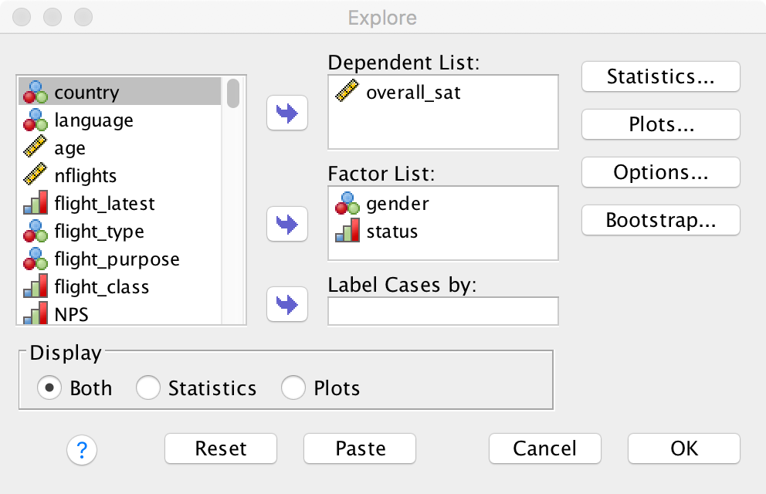
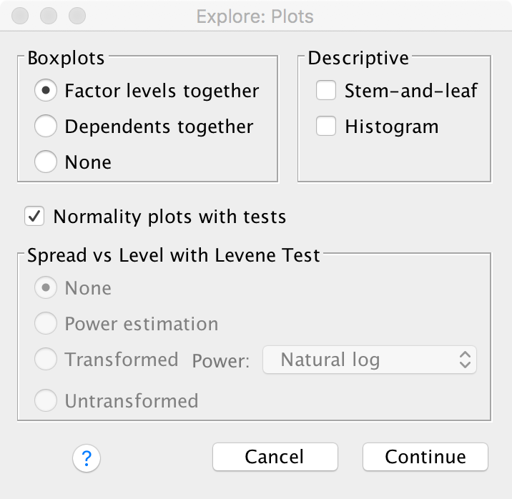
t-test
Click to add to factor list. For this example we only need gender but the next example relies on status, so we add both
Click on Plots
Testing for normality (Analyze ▶︎Descriptive Statistics ▶︎ Explore)
Tick Normality plots with tests

Slide 18
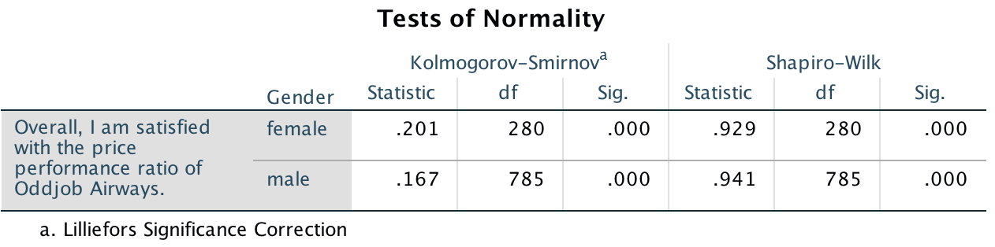
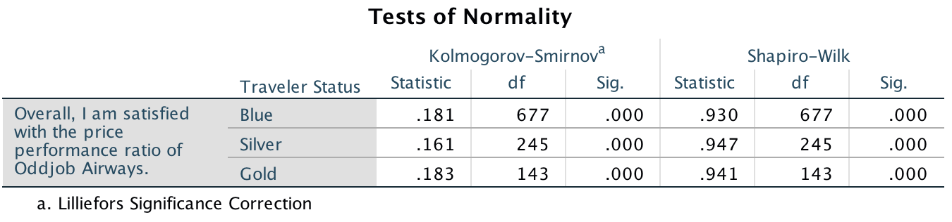
t-test
Consider the Shapiro-Wilk test since we have less than observations in each of the group being analyzed:
p-values smaller than 0.05 → the null hypothesis that the data in each group is normally distributed should be rejected at a 5% level
What is your conclusion?

Slide 19
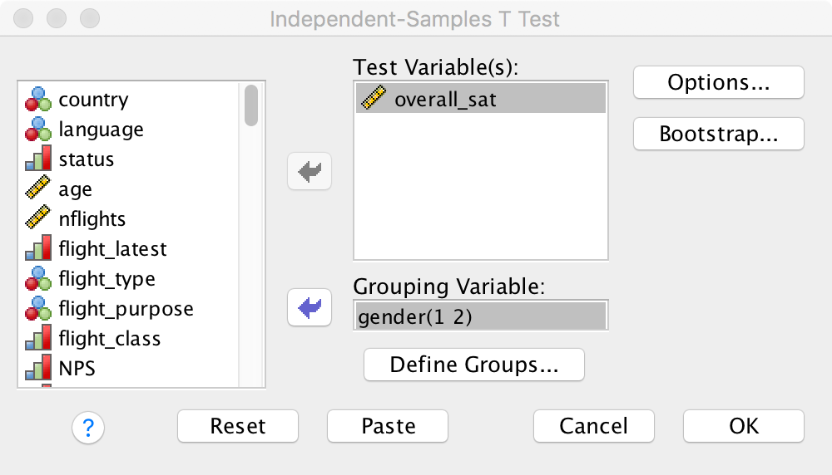
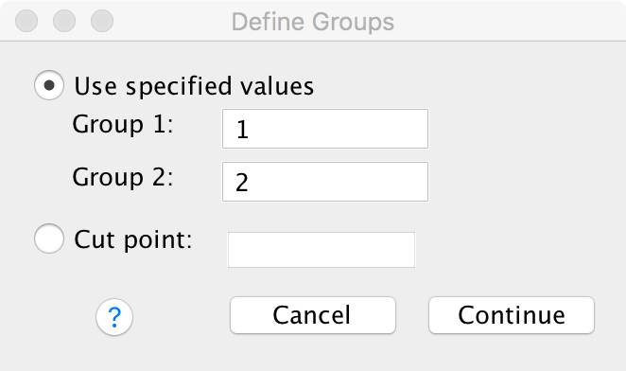
t-test
Click to define groups
Specify the grouping variable’s values that identify the two groups
Alternatively specify a cut point

Slide 20
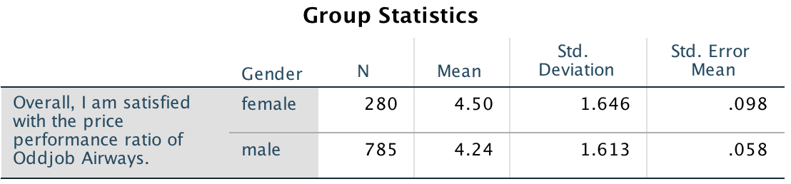
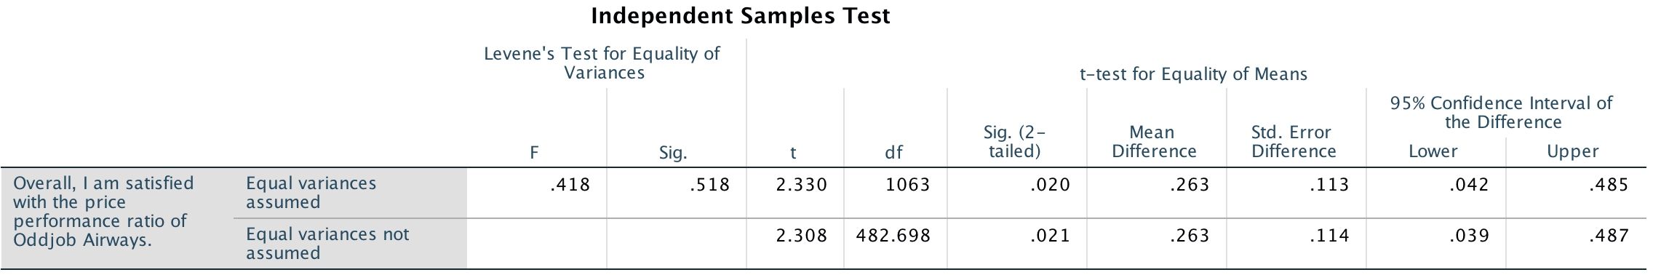
t-test
Female customers have a higher mean overall satisfaction (4.5) than males (4.24)
Null hypothesis that the population variances are equal cannot be rejected (large p-value of 0.518, low F-value of 0.418). Conclusion: choose the upper row for further analysis
The p-value of .020 is below the threshold value of 0.05 → reject the independent samples t-test’s null hypothesis that the overall satisfaction means of male and female travelers is the same; conclude the overall satisfaction means of male and female travelers differs (significantly at p<.05)

Slide 21
Comparing More than Two Means Analysis of Variance (ANOVA)
ANOVA
Research question
Example: Do customers across four different types of segments differ with regard to their attitude towards a certain brand?
Example: Is there a significant difference in hours spent on the internet per day between users of Facebook, Instagram, and Twitter?
The research questions could be answered with several pairwise comparisons or t-tests, but…
…the amount of comparisons grows up very rapidly: with 10 groups, we would have to carry out 45 group comparisons
…the overall chance of a type I error would increase: with 10 groups and a significance level of α = 0.05 the overall chance of a type I error would be 0.901 (α inflation trap)
Why ANOVA?
One-way ANOVA: examine mean differences between more than two groups, the variable indicating the groups is referred to as the factor
Two-way ANOVA: Extension to a second factor
MANOVA, ANCOVA,…
Types of ANOVA

Slide 22
Principles of Hypothesis Testing
1.
Check the assumptions
2.
Calculate the test statistic
3.
Make the test decision
4.
Carry out post hoc tests
5.
Measure the strength of effects
6.
Interpret the results

Slide 23
Comparing More than Two Means Analysis of Variance (ANOVA)
One-Way ANOVA: Basic Concept
H₀: μ₁ = μ₂ = μ₃
H₁: At least two of μ₁, μ₂, and μ₃ are different
The total variation in the data (indicated by SS_{T}) is separated into two parts: (1) the between-group variation (SS_{B}) (also “explained variation”), and (2) the within-group variation (SS_{W}) (also called “unexplained variation”/ “(random) noise”)).
A high proportion of between-group variation indicates a systematic influence of the group variable (type of promotion) on the independent variable (sales)

Slide 24
Comparing More than Two Means Analysis of Variance (ANOVA)
Post hoc tests reduce the danger of the α inflation
Post hoc test
Carry out Levene’s test to assess whether the population variances are equal
Population variances differ
Population variances are equal
Use the Games-Howell procedure
Check the group-specific sample sizes
Sample sizes are (approximately) the same
Sample sizes differ
Use the REGWQ procedure
Use Hochberg‘s GT2

Slide 25
Comparing More than Two Means Analysis of Variance (ANOVA)
The effect size measures the strength of the effects
Small samples sizes (< 50): η²
Higher sample sizes: ω²
Ratio of the between group variation (SS_{B}) to the total variation (SS_{T}) → variance accounted for in the sample data
Can take values between 0 and 1
If all groups have the same mean: η²=0
η² is often criticized for being inflated, for example due to small sample sizes
ω² adjusts for this bias
Values below 0.30 can be considered as weak effects, values between 0.30 and 0.59 as moderate effects and values higher than 0.60 as strong effects

Slide 26
Example using SPSS ANOVA
The second research question is: Does customers’ membership status (i. e., status as blue, silver, gold) relate to their overall price/performance satisfaction?
H₀: the mean of the overall price/performance satisfaction is the same between the status groups.
H₁: the mean of at least two status groups differ on price/performance satisfaction for the status groups.
What test to use?
We want to compare an interval or ratio scaled outcome variable across three independent samples. The choice of test is determined by whether the groups are normally distributed and have equal variances.
Recall from the earlier output (What was your conclusion?) that the samples were not normally distributed. Hence we should either use a One-way ANOVA or the Kruskal-Wallis rank test.

Slide 27
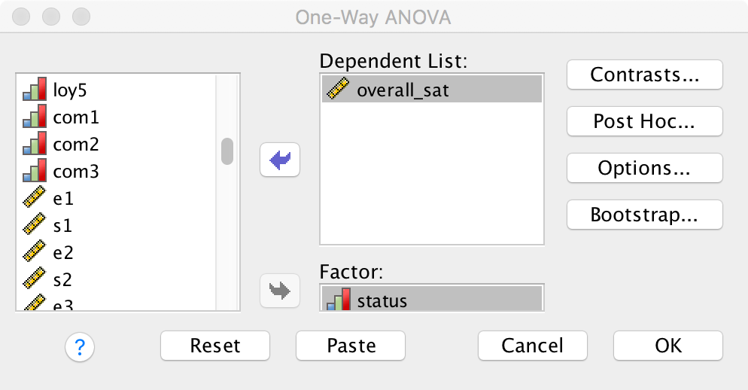
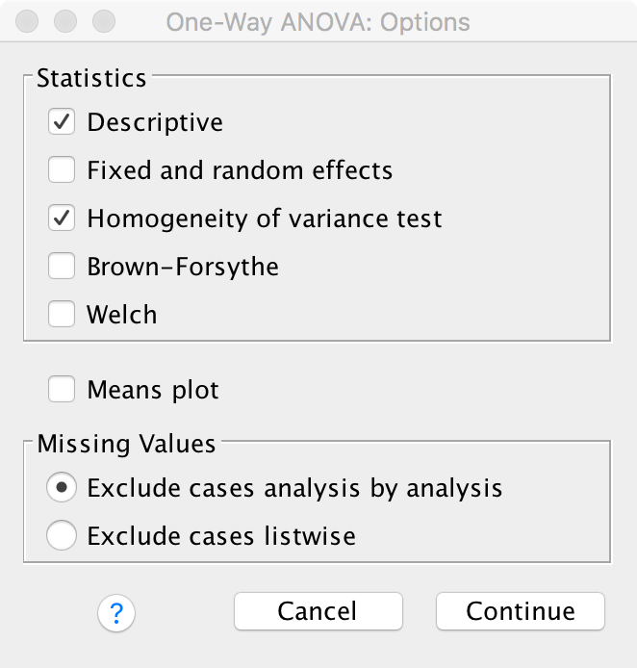
ANOVA
Add satisfaction
Under Post Hoc tick the required statistics
Under options tick the required statistics
Add status as the factor
Tick descriptives
Tick Homogeneity of variance test
You may want to tick Welch if the groups were normally distributed (they are not in this example)

Slide 28
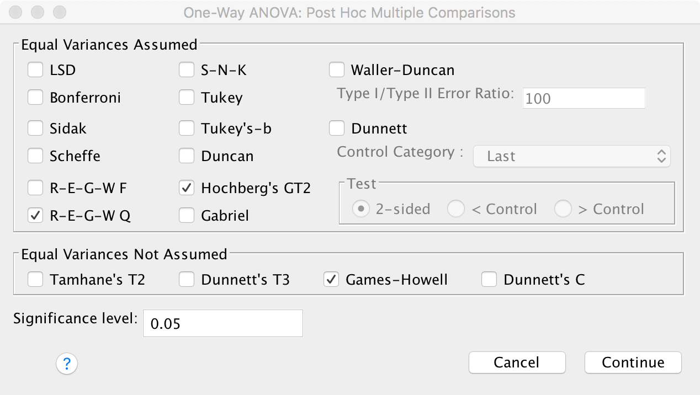
ANOVA
Tick R-E-G-W Q when you can assume equal variances but sample sizes are equal
Tick Hochberg’s GT2 when sample sizes differ
Tick Games-Howell when you cannot assume equal variances

Slide 29
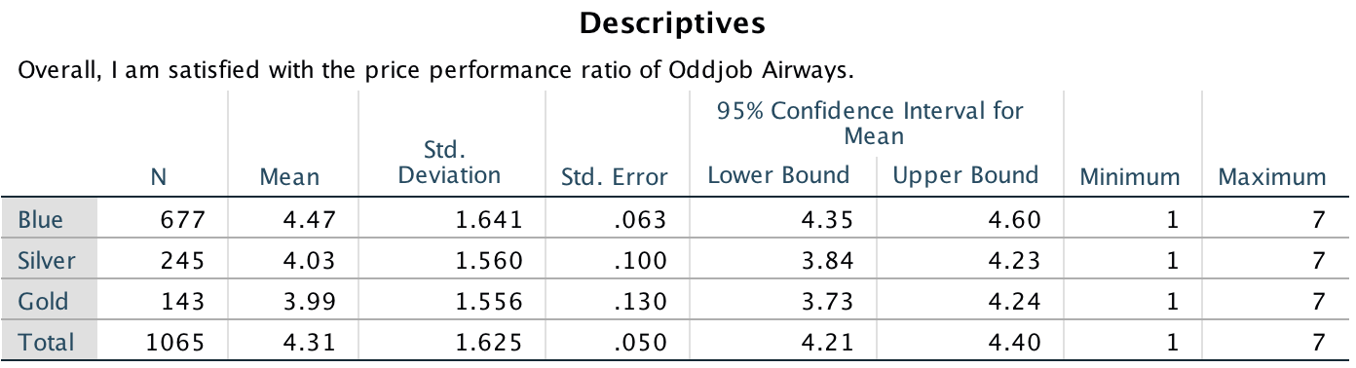
ANOVA
Descriptive analysis: sample sizes differ between the groups and there are some mean differences (which testing will reveal to be significant, or not).

Slide 30
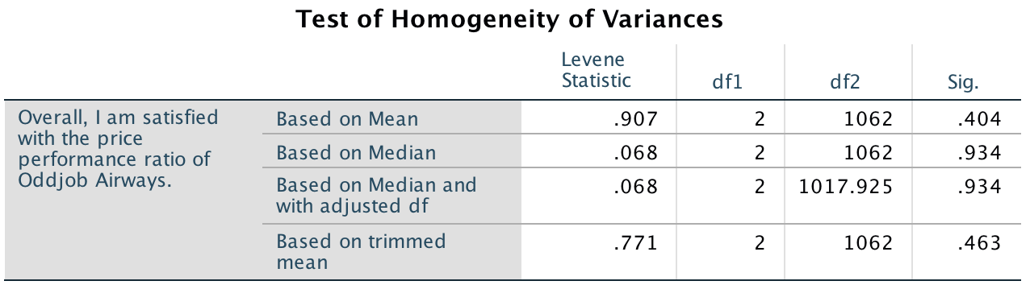
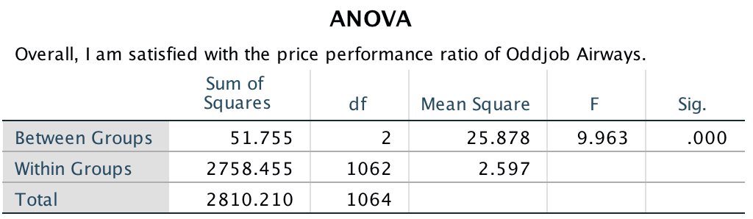
ANOVA
p-value (0.341) is clearly above 0.05 → consider the one-way ANOVA (instead of the Kruskal-Wallis rank test)
p-value ≤ 0.05 → reject the null hypothesis that the mean of the overall price/ performance satisfaction is the same between the status groups
→ Always consider the Levene’s test before interpreting the post hoc tests!

Slide 31
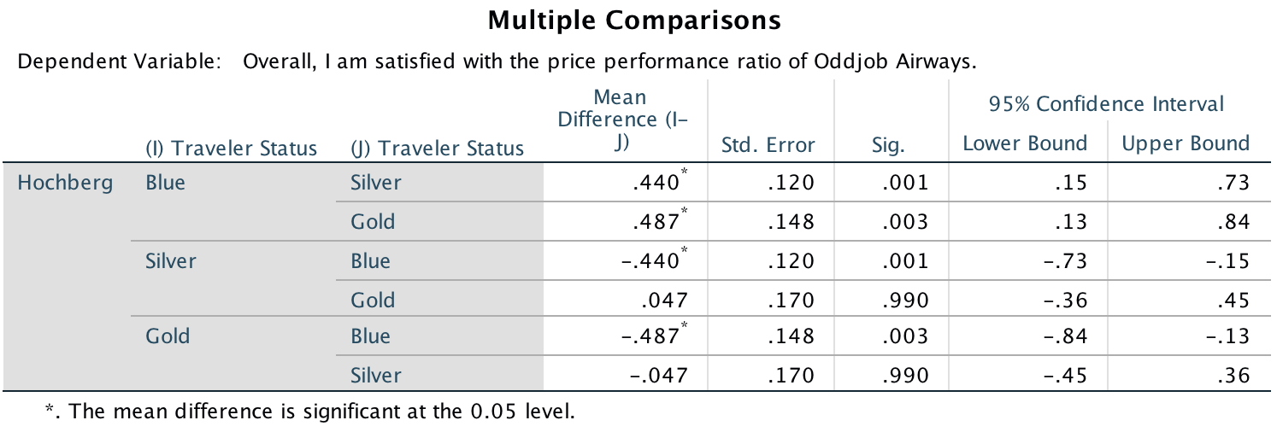
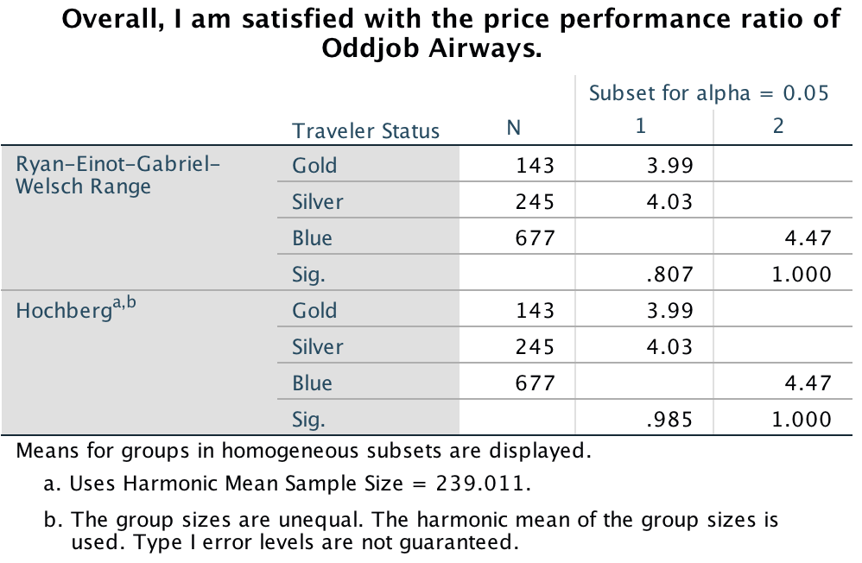
ANOVA
p-value (.001) is clearly below 0.05, therefore we conclude Silver is different from Blue. We can repeat this comparison for all other pairwise combinations
Which groups differ from each other? The Blue status is not in the same column as the Silver and Gold status, therefore we conclude they are significantly different from each other at p ≤ 0.05
→ We can manually calculate the effect size using section 6.6.2.5

